Slide 1

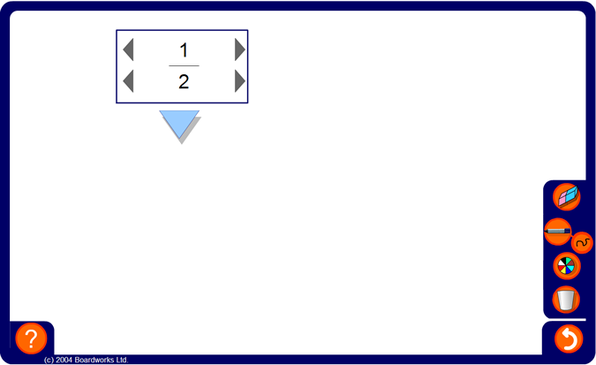



Converting fractions to decimals
Notes:
Explain that we may be asked to convert a fraction to a decimal without using a calculator.
Converting fractions to terminating decimals
Choose the configuration that supports denominators to 100. If you enter a fraction with a denominator of 2, 4, 5, 10, 20, 25, or 50 then the corresponding equivalent fraction out of 100 (or 10) will be displayed. Relate this to the decimal place value system and ask pupils to convert the fraction to a decimal before revealing the answer.
Extend the activity by choosing the configuration that supports denominators to 1000. If you enter a fraction with a denominator that is a factor of 1000, for example, 8, 40 or 125, then the corresponding equivalent fraction out of 10, 100 or 1000 will be displayed. Relate this to the decimal place value system and ask pupils to convert the fraction to a decimal before revealing the answer.
Use the pen tool to show pupils how the equivalent fractions over 10, 100 or 1000 are obtained by multiplying the numerator and the denominator by the same number.
Converting fractions to decimals by dividing
If the numerator of the fraction is not a factor of 1000 then the program will convert the fraction to a decimal by dividing the numerator by the denominator. State that this can also be done using a calculator or short division.
Investigating recurring decimals
Tell pupils that any fraction can be written as either a terminating decimal or a recurring decimal (and that any terminating or recurring decimal can be written as a fraction). You may also like to mention the existence of decimals that are irrational and cannot be expressed as a fraction, for example π or √2.
Investigate the patterns given by various recurring decimals.
For example, demonstrate the decimal equivalent of ¹/₉, ²/₉ and ³/₉ and ask pupils to predict the decimal equivalent of ⁴/₉, ⁵/₉, ⁶/₉ etc.
Repeat for other sequences such as: ¹/₇, ²/₇, ³/₇ … or ¹/₁₁, ²/₁₁, ³/₁₁ …

